Slide 1
Module 6
Sampling

Slide 2
Announcements

Slide 3
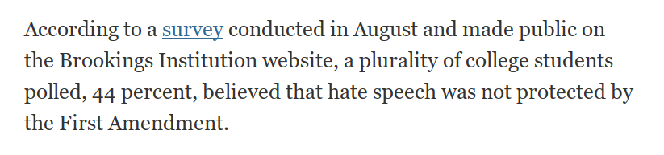

Slide 4
Sampling

Slide 5
Sampling
Deterministic sample:
Sampling scheme doesn’t involve chance
Probability sample:
Before the sample is drawn, you have to know the selection probability of every group of people in the population
Not all individuals have to have equal chance of being selected
(Demo)

Slide 6
Sample of Convenience
Example: sample consists of whoever walks by
Just because you think you’re sampling “at random”, doesn’t mean you are.
If you can’t figure out ahead of time
what’s the population
what’s the chance of selection, for each group in the population
then you don’t have a random sample

Slide 7
Attendance
bit.ly/attend8

Slide 8
Distributions

Slide 9
Probability Distribution
Random quantity with various possible values
“Probability distribution”:
All the possible values of the quantity
The probability of each of those values
In some cases, the probability distribution can be worked out mathematically without ever generating (or simulating) the random quantity
(Demo)

Slide 10
Empirical Distribution
Based on observations
Observations can be from repetitions of an experiment
“Empirical Distribution”
All observed values
The proportion of counts of each value
(Demo)

Slide 11
Large Random Samples

Slide 12
Law of Averages
If a chance experiment is repeated many times,
independently and under the same conditions,
then the proportion of times that an event occurs
gets closer to the theoretical probability of the event
As you increase the number of rolls of a die, the proportion of times you see the face with five spots gets closer to 1/6
(Demo)

Slide 13
Large Random Samples
If the sample size is large,
then the empirical distribution of a uniform random sample
resembles the distribution of the population,
with high probability

Slide 14
Probability & Simulation

Slide 15
Calculation
Roll a fair die 4 times.
What is P(get at least one 6)?
(Demo)

Slide 16
Statistics

Slide 17
Why sample?
Probability
Statistics
Sampling

Slide 18
Estimation
Statistical Inference:
Making conclusions based on data in random samples
fixed
Example:
Use the data to guess the value of an unknown number
depends on the random sample
Create an estimate of the unknown quantity

Slide 19
Terminology
Parameter
A number associated with the population
Statistic
A number calculated from the sample
A statistic can be used as an estimate of a parameter
(Demo)

Slide 20
Module 6
Statistics

Slide 21
Announcements

Slide 22
Project 1
gapminder.org/tools
Notes:
https://www.gapminder.org/tools/#_locale_id=en;&state_time_value=1960;&marker_axis/_x_which=children/_per/_woman/_total/_fertility&domainMin:null&domainMax:null&zoomedMin:null&zoomedMax:null&scaleType=linear;&axis/_y_which=child/_mortality/_0/_5/_year/_olds/_dying/_per/_1000/_born&domainMin:null&domainMax:null&zoomedMin:null&zoomedMax:null&scaleType=log;;;&chart-type=bubbles

Slide 23
Probability & Simulation

Slide 24
Calculation
Roll a fair die 4 times.
What is P(get at least one 6)?
(Demo)

Slide 25
Calculation
Roll a fair die 20 times. What is P(get at least one 6)?
Three ways to compute it:
Calculation: Use math.
Enumeration: Count all outcomes.
Estimation: Randomly sample outcomes. Estimate.

Slide 26
Attendance
bit.ly/attend8

Slide 27
Statistics

Slide 28
Why sample?
Probability
Statistics
Sampling

Slide 29
Estimation
Statistical Inference:
Making conclusions based on data in random samples
fixed
Example:
Use the data to guess the value of an unknown number
depends on the random sample
Create an estimate of the unknown quantity

Slide 30
Terminology
Parameter
A number associated with the population
Statistic
A number calculated from the sample
A statistic can be used as an estimate of a parameter
(Demo)

Slide 31
Estimation

Slide 32


How many enemy planes?

Slide 33
Assumptions
Planes have serial numbers 1, 2, 3, …, N.
We don’t know N.
We would like to estimate N based on the serial numbers of the planes that we see.
The main assumption
The serial numbers of the planes that we see are a uniform random sample drawn with replacement from 1, 2, 3, …, N.

Slide 34
Discussion question
If you saw these serial numbers, what would be your estimate of N?
170 271 285 290 48
235 24 90 291 19
One idea: 291. Just go with the largest one.

Slide 35
The largest number observed
Is it likely to be close to N?
How likely?
How close?
Option 1. We could try to calculate the probabilities and draw a probability histogram.
Option 2. We could simulate and draw an empirical histogram.
(Demo)

Slide 36
Verdict on the estimate
The largest serial number observed is likely to be close to N.
But it is also likely to underestimate N.
Another idea for an estimate:
Average of the serial numbers observed ~ N/2
New estimate: 2 times the average
(Demo)

Slide 37
Module 6
Simulation

Slide 38
Announcements

Slide 39
Prediction and Simulation

Slide 40
Mendel's Pea Plants
Gregor Mendel (1822-1884) was an Austrian monk and founder of the modern field of genetics. His theories predicted that pea plants will bear purple or white flowers at random, in the ratio 3:1.
He planted 929 plants. Can we predict how many will have purple flowers, if his theories are right?
(Demo)

Slide 41
Mendel's Observations
Mendel observed 705 of the 929 plants had purple flowers.
Does this sound consistent with our predictions?
(Demo)

Slide 42
Different Statistics
The statistic was "proportion of plants with purple flowers". We could have chosen a different statistic, and predicted the values of that statistic.
(Demo)

Slide 43
Attendance
bit.ly/attend8

Slide 44
Predictions: Swain v. Alabama

Slide 45
Jury Panels
Eligible jurors in a county
List of eligible residents
Jury panel
Jury
Section 197 of California's Code of Civil Procedure: All persons selected for jury service shall be selected at random, from a source or sources inclusive of a representative cross section of the population of the area served by the court.
Sixth Amendment to the US Constitution: … the accused shall enjoy the right to a speedy and public trial, by an impartial jury of the state and district wherein the crime shall have been committed.

Slide 46
Robert Swain v. Alabama
1965 Supreme Court case about jury selection
In Talladega, Alabama, 26% of residents were black
In Swain's jury panel, 8 of 100 panelists were black
All 8 were struck from the jury by the prosecution (using peremptory challenges)
Ruling: "The overall percentage disparity has been small and reflects no studied attempt to include or exclude a specified number of [black men]."
(Demo)

Slide 47
Estimation

Slide 48
Perfect information
You want to know how many US voters support a particular policy.
You could ask everyone. That works.
But, sometimes we can't afford to do that. So, instead, we could ask some of them, and draw inferences about the general population.

Slide 49
A common scenario
You have to make a decision based on incomplete information.
The quality of your decision is affected by
the information that you have
the information that you don’t have
So, before making the decision, it is worth examining why and how your information came to be incomplete.

Slide 50
Terminology
Population: A collection of individuals
All flights out of SFO last summer
Variable: Something that varies in the population
airline (categorical variable)
amount of delay in departure (quantitative variable)
Sample: A subset of the population

Slide 51
Why take a sample?
You want to understand the variable in the population,
but
you don’t have the resources to measure the variable on all the individuals in the population,
so
you just measure it on a subset of them.

Slide 52
“Tickets in a box”
sample
population

Slide 53
Best way to draw the sample
At random!

Slide 54
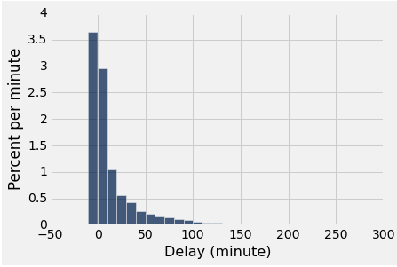
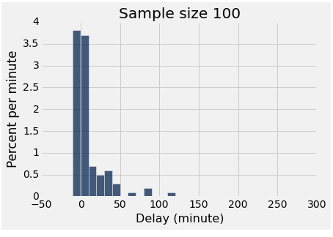
Two distributions
distribution of the population
empirical distribution of a sample

Slide 55
Why sample at random?
The empirical distribution
of a large random sample
is very likely to be close
to the distribution of the population.
That’s why.

Slide 56
The effect of sample size
Larger random samples are more likely to resemble the population than smaller ones.
However, if the method of sampling is not random, taking a larger sample isn’t necessarily better.
You could just end up with a big bad sample.

Slide 57
More terminology
Parameter: A number calculated using the values in the population
Median delay among all flights
Proportion of voters who are Republican
Statistic: A number calculated using the values in a sample
A statistic can be used as an estimate of a parameter.

Slide 58
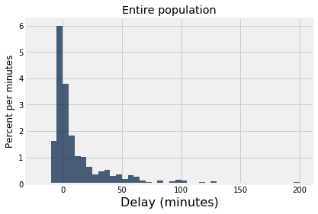
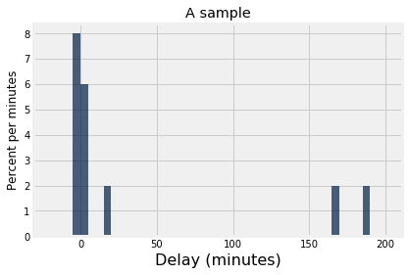
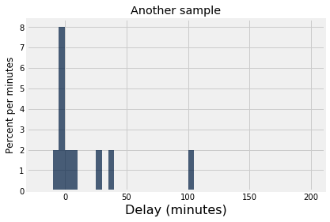
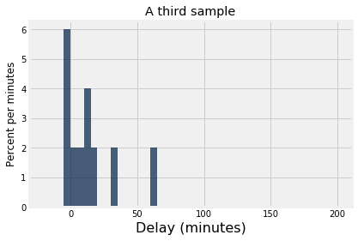
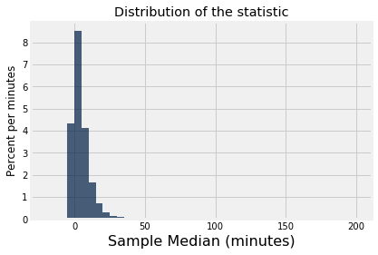
randomly sample
randomly sample
randomly sample
median = 2.0
median = -0.5
median = 9.5

Slide 59
If you have the entire population...
Formulate a question you want to answer (a parameter of the population).
Visualize the data (the population).
Compute the answer.
Interpret the results, and explain them in language without statistical jargon.

Slide 60
If you don't...
Formulate a question you want to answer (a parameter of the population).
Select a method of inference.
Visualize the data (the sample).
Calculate the statistic on your sample, then apply the method to estimate the population parameter.
Interpret the results, and explain them in language without statistical jargon.

Slide 61
Things you now know how to do...
How much error should I expect in my estimate?
How can I choose between multiple methods of estimation?
How large a sample will I need?

Slide 62
Module 6
Chance Examples

Slide 63
Announcements

Slide 64
Attendance
bit.ly/attend8

Slide 65
Probability

Slide 66
Rules of Probability
Multiplication Rule: The chance two events both happen = (the chance the first event happens) * (the chance the second happens, given the first happens)
Addition Rule: The chance an event happens = (the sum of the chances of all different ways it can happen), as long as no two of those ways can both happen
Complement Rule: The chance an event doesn't happen = 1 - (the chance that it does happen)

Slide 67
Coins
If you flip 3 coins, what is the chance that an odd number of heads come up?
Chance of 3 heads: (½) * (½) * (½) for HHH
Chance of 1 head: HTT or THT or TTH
(Demo)

Slide 68
Samples
If you sample at random with replacement 79 times from the course instructional staff (80 people), what is the chance that I am never chosen?
If you sample at random without replacement 79 times from the course instructional staff (80 people), what is the chance that I am never chosen?

Slide 69
Samples of Coins
There are 3 coins: 2 fair coins and 1 two-headed coin. 10 times, you pick a coin at random and flip it. What's the chance that at least one tail comes up in those 10 flips?
An easier problem: What's the chance of all heads?
An even easier problem: What's the chance of one head?
1/2
Head
2/3
Fair coin
Tail
1/2
1
Head
1/3
2-headed
0
Tail

Slide 70
Estimation

Slide 71
Estimating the Interval Width
Given np.random.choice(np.arange(start, end), k) for unknown start & end, how can we estimate end-start?
10, 11, 12, 13, 14, 15, 16, 17, …, 48, 49
21, 28, 24, 37, 24, 31, 29, 12, 40, 20, 38, 23
(Demo)

Slide 72
Estimating a Probability
There are 3 coins: 2 fair coins and 1 two-headed coin. 10 times, you pick a coin at random and flip it. What's the chance that at least one tail comes up in those 10 flips?
(Demo)

Slide 73
Histograms

Slide 74
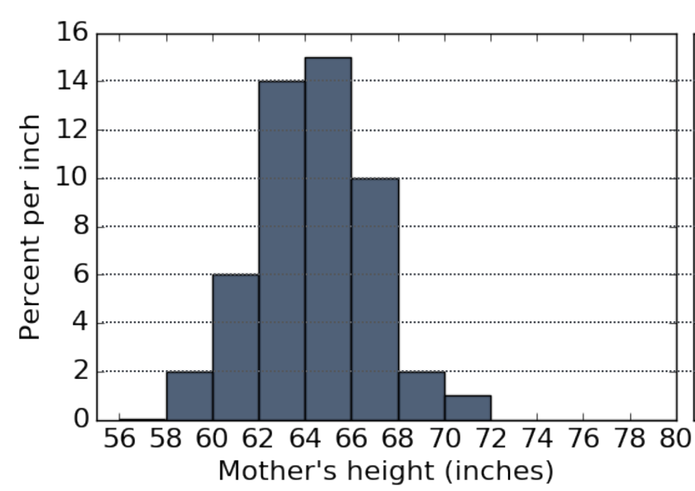
Changing the Bins
If the two bins from 58-60 and 60-62 were redrawn as one bin, what would be the height of its bar?
4? 8? Unknown?

Slide 75
Intervals Around Unknown Values
How tall is the tallest mother?
How much taller is the tallest mother than the shortest mother?

Slide 76
Data Science Degrees

